Slide 1



Spotify Warped: Weaving Personal Music Histories into Meaningful Narratives
Summer Undergraduate Research Experience Symposium
Robert Jarman
July 31, 2025

Slide 2
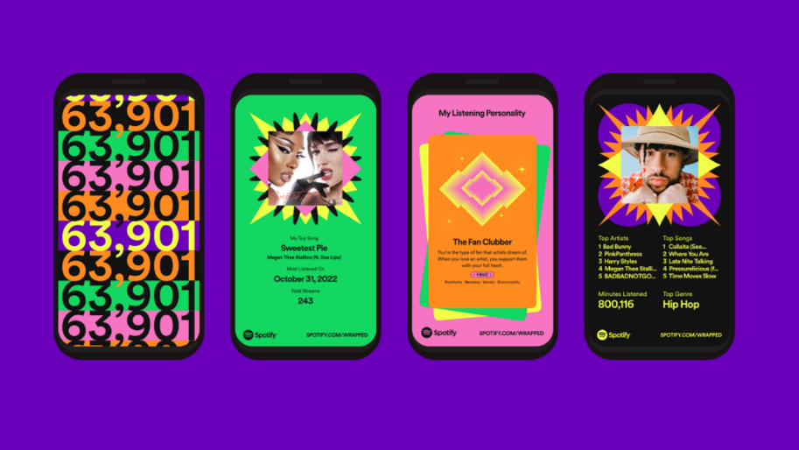



What is this Project About?
Why Spotify Warped?
Static broad Spotify Wrapped
Dynamic narrative-driven engagement to foster self‑reflection
Technical Underpinnings
Python/JavaScript data pipeline + external Application Programming Interfaces
D3.js for interactive graphics; HTML/CSS for responsive UIKey Findings
Geographic hotspots of discovery tied to travel

Slide 3
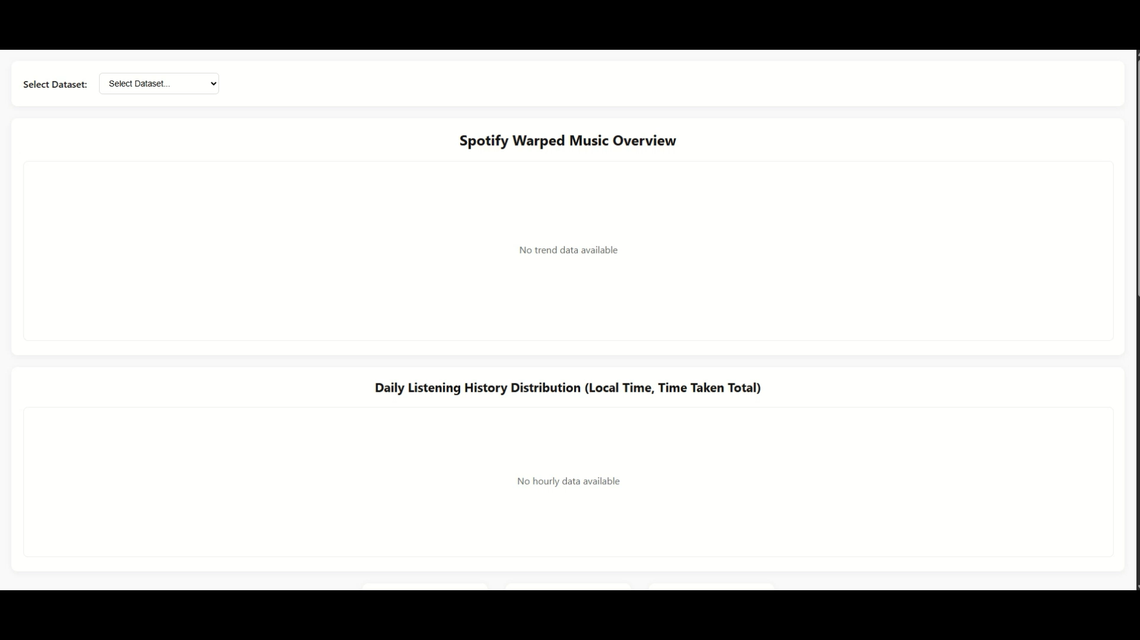
Video Demonstration
Notes:
Script from audio:
let me click on user. You can click on the month.
In this chart that I'm over, say this…. Do November 2017?
You see the minutes listed? Then we were down, you see this chart where it basically gives you, like, an average, um.
Breakdown. Alright, it looks like.
And then, um…. Down here on Timeline, you can check out to see.
Yes, so, okay, we saw the user first. So, you can select user 1.
And I'm here, basically it'll generate all the information needed. You'll see a trend line here. In this trend line, you can see….
Over a month, so say we choose November 2017, you see the minutes listed.
Uh, then below here, you'll see the bar chart. Sean, basically, the distribution of listening.
Below that, you see some of your stats, in general. And the timeline. You can choose aimed amongst the existing music.
So, here real quick, 2016. Um, let's say June 24th.
In public view, and a debut as well. Um, and she's the artist alone.
In Google Locations, and we can click on a country. Say we click, uh, France.
And then you'll see the summary stats in general. Go to timelines.
And all the checks we've played in that country. Ordered from, uh, recently played to least listen.
Least listen to? So, pretty much, like, earnest.
Can you see the artist, um…. Sparkline, and the Sparkline, it gives you storytelling about how the artist.
Actually, if you notice here, Harley Hubbornstone. They never listened to her before.
Until about mid-2020. And the big speed, uh, spike?
In mid-2022, because that, um, user went to a concert from that artist.
And once they enjoy a lot, so there's a lot more. So you can see a big spike in listening for that artist.
We got another mall and another user. Says it quick. Um….
You know, for this month for you, let's do…. July 2024?
You can see the minutes, you see a little distribution chart here?
Bar graph, essentially. Um, and that's average. How much music you listen to per hour?
So here we have the, um, database when it loads up on the webpage.
Um, you can click a user, so let's say user 1, for example.
All these are anonymous at the moment. So essentially here, you'll see the, um….
Distribution, um, trend line. Of different months throughout the years.
So, let's say we hover over 2022 in January. 407, right? 723, right?
One, you see the minutes played. Save that 100 minutes, over.
Do you see a bar chart with the distribution? The easier timeline, and you can select the years.
So let's say you select, uh, 2016. Let's go to June 24th.
You'll see a day view of the summary stats. You also see device usage by Tron.
You see a bar chart full of hours. The events played in that day.
Power distribution, uh, precisely. And you'll also see tracks played.
So, and then over here, you'll see a little color-coded heat map.
It is all heatmap in, like, a year heat map, essentially.
Did. You should, um…. Locations.
Let's say, you know, France. As well, you'll see the summary stats for that country.
While you're listening to music and using the time periods. For one year in that country.
Oil listed musician and Country, at least, but it can also show trends of when you're on vacation there.
Is an order from, um…. Most recent to least recent.
As code could on the map. Artist, you can see here, uh.
Artist Park Lines, and we list the most and least. Actually, storytell would tell us that, um.
They actually, um…. Went to a concert with them in 2022.
We're going to that concert and started listening to a lot more of their music afterwards, which is that big spike you see over here.
As if I'm now using two. You see how well this month? Uh, September 2023.
Then, you see a bar chart again. Showing our distribution on average.
How much of the music per, uh…. Which also gives diurnal trends for sleep patterns.
The artist, um, trend lines. The spark lights, they show this, um, user was to allow the same artist throughout their time.
But also, you'll notice the timeline's much smaller than the other, um.
Dataset we have. Locations. Didn't visit as main country, so that user.
Let's say for the United States. You see it's been on a time, easy to hover.
Future shows there, and you got the summary stats included in the, um, timelines.
At all the tracks played in that country? As well. Can I say 1,000?
On the timeline, you can select a year, let's say, um….
Let's say this on the remote team.
See this date, and you can see the job number… oh, it's go on to see the date, categorize it based on desktop.
Get in contact form, so maybe this user. Based on storytelling, you can tell that they were probably on vacation, on holiday during this time period.
Um, for the holiday season, so if I have more time to actually do relaxation, so they're probably, um.
Came in, wow, flew back home. You can imagine.
After this year, though? Than the last user? User 3?
You get over a month, remember? And you can see….
The bar chart again, the timeline. You can select.
Let's say 2023. This came from February?
Ducey just above you. You don't have to see the whole year.
I also can hover to see time for each day. Here, at the same time here.
It's the same time to click on it.
Locations. Canda selected, equals you visit that country. Same information.
At August, you can see the artist timeline as well here.
You can see how, like. I know the Chancellor and Shane Cole.
Blowing, uh, logic. They all had much lessons throughout Top of the person we can learn from a lot more.
You can see how they gradually decreases.

Slide 4
Next Steps
Podcast listening analysis
Genre‑classification via Machine Learning
User folder upload feature for full Streaming History data & most‑streamed day block

Slide 5
Thank You

